Slide 1
JavaScript
Sangeeta

Slide 2
What is JavaScript?
Browsers have limited functionality
Text, images, tables, etc.
JavaScript allows for interactivity
Perform calculations
Validation of input
Browser/page manipulation
Reacting to user actions
A type of programming language (Object Based and Interpreted)
Easy to learn
Developed by Netscape
Now works in all major browsers
is used in millions of Web pages to improve the design, validate forms, detect browsers, create cookies, and much more
Notes:
When the web was conceived, browsers were limited to text and image - later tables and frames. The extent to which they provided interactivity with the user was very limited. JavaScript was developed by Netscape as a simple programming language (often referred to as a scripting language). It is easy to learn and small sections of JavaScript can be added to a web page rather than needing to develop complicated programs. It was specially designed for web page interaction and manipulating the web browser and page elements. It is often used to respond to user actions such as mouse clicks.
Although developed by Netscape, and other variants exist, such as Jscript from Microsoft, a standard has been developed by the European Computer Manufacturers Association. It is known as ECMAScript, using the standard ECMA262, which can be found fully documented at the address on the slide.

Slide 3
How Does It work?
Embedded within HTML page
View source
Executes on client
Fast, no connection needed once loaded
Simple programming statements combined with HTML tags
Interpreted (not compiled)
No special tools required
Ending Statements With a Semicolon?
Semicolons are optional! Required if you want to put more than one statement on a single line.
Case sensitive
Notes:
JavaScript is embedded/included within HTML. You can often see JavaScript in the source of a web page or it is provided for information on the page as with the calculator example.
JavaScript is mainly used as a client-side language - it downloads with the web page. Once the page has downloaded and is on the users' machine, it is actually the web browser which then interprets the JavaScript instructions. JavaScript pages run quickly, you are not relying on an internet connection to a web server. Short pieces of JavaScript can be combined with HTML without the need to develop a fully blown program.
There are two types of computer language, compiled and interpreted. To write or edit a compiled language requires a special piece of software called a compiler. JavaScript belongs to the other category, called interpreted. In the case of JavaScript, this interpretation is done by the browser software at run-time. Because JavaScript is interpreted, this means that no special tools are required to write or edit JavaScript, just a normal text editor. JavaScript web pages can be platform independent i.e. they will run on different browsers and computers (as long as the browser is JavaScript enabled). If you see a JavaScript web page that you like, you may be able to take that JavaScript and use it for your own purposes. (Remember to acknowledge the original author!)

Slide 4
What is Java?
Totally different
A full programming language
Much harder!
A compiled language
Independent of the web
Notes:
Java is often confused with JavaScript. JavaScript was originally called LiveScript, but due to the popularity of Java at the time, it was renamed JavaScript . Java is different from JavaScript in a number of significant areas:
Java is a full programming language which can do just about anything - JavaScript isn't and can only do relatively simple things.
Java is much harder to learn and takes much longer to master.
Java is compiled. The language is not 'embedded' or written in the page - it is self-contained as a separate file.
Java can be used/written totally independently from the web - JavaScript works with web browsers only.
They are sometimes used together - JavaScript can be used to 'control' or configure Java 'applets'.
This talk does not cover Java in any more detail.
A separate Netskills Training Module investigates the use of Java applets.

Slide 5
JavaScript Statements
<html>
<head><title>My Page</title></head>
<body>
<script language="JavaScript">
document.write('This is my first
JavaScript Page');
</script>
</body>
</html>
Notes:
JavaScript can be contained either in the header section of an HTML page or in the body. This JavaScript statement is shown as a pure JavaScript statement within SCRIPT tags.
Notice that there is no HTML in the body of this page at all. (Demonstrate what this JavaScript looks like in a web browser).
This statement writes a line of text on a web page.
The command document.write is a standard function in JavaScript to write text to the page. The following is a more technical explanation for background information only:
document.write is derived from the JavaScript object model (not covered in detail here). It works on the principle that all document and browser elements have an object name (document, window, image etc) and can each has various properties that can be manipulated. The object hierarchy means that individual elements can be uniquely identified i.e. document.myform.mytext would refer to the text entry named mytext within the form called myform within the current page (document).
The arrow symbol '→' is used in these slides and in the workbook to indicate where a JavaScript statement should be typed on one line without a break. A line break in the wrong place will stop JavaScript from working.e.g.
document.write('This is my first →
JavaScript Page');
should actually be typed:
document.write('This is my first JavaScript Page');

Slide 6
JavaScript Statements
<html>
<head><title>My Page</title></head>
<body>
<script language=‘’JavaScript’’>
document.write(‘<h1>This is my first JavaScript Page</h1>’);
</script>
</body>
</html>
HTML written
inside JavaScript
Notes:
This example demonstrates that anything included within the quotes in the document.write statement is printed to the screen, and this includes HTML tags. The <h1> tag is delivered to the browser along with the text, and the browser would interpret it as a normal HTML file, displaying the text in the Heading 1 style.
IMPORTANT NOTE:
This example shows a JavaScript statement in the <body> of the web page.
It is possible to include JavaScript statements in the <head> section of a web page but care must be taken that they do not try to access items that don't exist until the page has loaded (e.g. form elements, links, images). The web browser parses (reads through and executes) any script commands as it displays the page.
In most cases it is common sense that dictates where a statement should be placed.
If, in the above example, document.write was placed in the <head> of the page, the text "This is my first JavaScript Page" would appear in the <head> of the finished page – this would be incorrect – although modern browsers will let you get away with it!
In some circumstances you may wish to use document.write in the <head> - for example to dynamically generate <meta> or <title> tags. Such uses are not considered here.
JavaScript functions are typically defined in the <head> section of a web page as they do not normally execute until they have been triggered elsewhere. The use of functions in JavaScript is covered in the Netskills Training Module: "Further JavaScript (Enhancing JavaScript with Functions and Events)"

Slide 7
Variables

Slide 8
Some variable names
My_variable
$my_variable
1my_example
_my_variable
@my_variable
My_variable_example
++my_variable
%my_variable
#my_variable
~my_variable
myVariableExample
Legal
Illegal

Slide 9
DATA Type

Slide 10
Data Types
JavaScript allows the same variable to contain different types of data values.
Primitive data types
Number: integer & floating-point numbers
Boolean: logical values “true” or “false”
String: a sequence of alphanumeric characters
Composite data types (or Complex data types)
Object: a named collection of data
Array: a sequence of values

Slide 11
Numeric Data Types
It is an important part of any programming language for doing arithmetic calculations.
JavaScript supports:
Integers: A positive or negative number with no decimal places.
Ranged from –2⁵³ to 2⁵³
Floating-point numbers: usually written in exponential notation.
3.1415…, 2.0e11

Slide 12
Example
var length = 16; // Number var lastName = "Johnson"; // String
var salary = 1000.24 // Real Number var cars = ["Saab", "Volvo", "BMW"]; // Array var x = {firstName:"John", lastName:"Doe"}; // Object
Javascript has dynamic types
var x; // Now x is undefined var x = 5; // Now x is a Number var x = "John"; // Now x is a String

Slide 13
Example
You can use the JavaScript typeof operator to find the type of a JavaScript variable:
typeof "John" // Returns string typeof 3.14 // Returns number typeof false // Returns boolean typeof [1,2,3,4] // Returns object typeof {name:'John', age:34} // Returns object

Slide 14
Array
An Array contains a set of data represented by a single variable name.
Arrays in JavaScript are represented by the Array Object, we need to “new Array()” to construct this object.
The first element of the array is “Array[0]” until the last one Array[i-1].
E.g. myArray = new Array(5)
We have myArray[0,1,2,3,4].

Slide 15
Array Example
<script language=“JavaScript”>
Car = new Array(3);
Car[0] = “Ford”;
Car[1] = “Toyota”;
Car[2] = “Honda”;
document.write(Car[0] + “<br>”);
document.write(Car[1] + “<br>”);
document.write(Car[2] + “<br>”);
</script>
You can also declare arrays with variable length.
arrayName = new Array();
Length = 0, allows automatic extension of the length.
Car[9] = “Ford”; Car[99] = “Honda”;

Slide 16
JavaScript Operators
Arithmetic Operators
Operator | Description | Example | Result
+ | Addition | x=2 | 4
 |  | y=2
 |  | x+y
- | Subtraction | x=5 | 3
 |  | y=2
 |  | x-y
* | Multiplication | x=5 | 20
 |  | y=4
 |  | x*y
/ | Division | 15/5 | 3
 |  | 5/2 | 2,5
% | Modulus (division remainder) | 5%2 | 1
 |  | 10%8 | 2
 |  | 10%2 | 0
++ | Increment | x=5 | x=6
 |  | x++
-- | Decrement | x=5 | x=4
 |  | x--

Slide 17
JavaScript Operators – 2
Assignment Operators
Operator | Example | Is The Same As
= | x=y | x=y
+= | x+=y | x=x+y
-= | x-=y | x=x-y
*= | x*=y | x=x*y
/= | x/=y | x=x/y
%= | x%=y | x=x%y

Slide 18
JavaScript Operators - 3
Comparison Operators
Operator | Description | Example
== | is equal to | 5==8 returns false
=== | is equal to (checks for both value and type) | x=5
 |  | y="5"
 |  | x==y returns true
 |  | x===y returns false
!= | is not equal | 5!=8 returns true
> | is greater than | 5>8 returns false
< | is less than | 5<8 returns true
>= | is greater than or equal to | 5>=8 returns false
<= | is less than or equal to | 5<=8 returns true

Slide 19
JavaScript Operators - 4
Logical Operators
Operator | Description | Example
&& | and | x=6
 |  | y=3
 |  | (x < 10 && y > 1) returns true
|| | or | x=6
 |  | y=3
 |  | (x==5 || y==5) returns false
! | not | x=6
 |  | y=3
 |  | !(x==y) returns true

Slide 20
JS Examples -1
<html>
<head><title>My Page</title></head>
<body>
<script>
x=3
y=20*x+12
alert(y)
</script>
</body>
</html>

Slide 21
Examples -2
<html>
<head><title>My Page</title></head>
<body>
<script>
s1 = 10
s2 = 20
s1 = s1+s2
document.write('hello' +s2)
</script>
</body>
</html>

Slide 22
Conditional statements

Slide 23
Conditional and Repetition Statements
Conditional statements:
if statement - use this statement if you want to execute some code only if a specified condition is true
if...else statement - use this statement if you want to execute some code if the condition is true and another code if the condition is false
if...else if....else statement - use this statement if you want to select one of many blocks of code to be executed
switch statement - use this statement if you want to select one of many blocks of code to be executed
Repetition structure: four in JavaScript
while
do…while
for
for…in

Slide 24
var r = confirm("Press a button"); if (r == true) { x = "You pressed OK!"; } else { x = "You pressed Cancel!"; }
document.write('x='+x);

Slide 25
Try it yourself? Output?
if (confirm("Do you agree"))
{alert("You agree")}
else{alert ("You do not agree")};

Slide 26
for (i = 0; i < 5; i++) { text += "The number is " + i + "<br>"; }
for/in statement loops through the properties of an object:
var person = {fname:"John", lname:"Doe", age:25}; var text = ""; var x; for (x in person)
{ text += person[x]; }

Slide 27
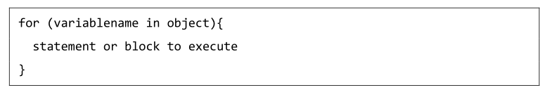
For .. In loop

Slide 28
For .. In loop
Example 1:
<html>
<body>
<script type="javascript">
var person = {fname:"John", lname:"Doe", age:25}; var text = ""; var x; for (x in person) { text += person[x]; }
document.write(text);
document.write ("Exiting from the loop!");
</script>

Slide 29
For .. In loop
Example 2:
<html>
<body>
<script type="text/javascript">
<!--
var aProperty;
document.write("Navigator Object Properties<br /> ");
for (aProperty in navigator)
{
document.write(aProperty);
document.write("<br />");
}
document.write ("Exiting from the loop!");
//-->
</script>

Slide 30
For .. In loop
Example 2:
Output:
Navigator Object Properties
serviceWorker
webkitPersistentStorage
webkitTemporaryStorage
geolocation
doNotTrack
onLine
languages
Language
…

Slide 31
Type of prompt Box

Slide 32
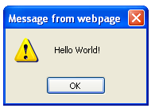
JavaScript Popup Boxes
Alert Box
An alert box is often used if you want to make sure information comes through to the user.
When an alert box pops up, the user will have to click "OK" to proceed.
<script>
alert("Hello World!")
</script>

Slide 33
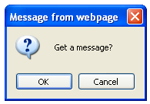
JavaScript Popup Boxes - 2
Confirm Box
A confirm box is often used if you want the user to verify or accept something.
When a confirm box pops up, the user will have to click either "OK" or "Cancel" to proceed.
If the user clicks "OK", the box returns true. If the user clicks "Cancel", the box returns false.
<script>
confirm("Get a message?");
</script>

Slide 34
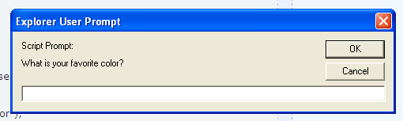
JavaScript Popup Boxes - 3
Prompt Box
A prompt box is often used if you want the user to input a value before entering a page.
<script>
prompt("What is your favorite color?", "");
</script>

Slide 35
JavaScript Popup Boxes - 3
Prompt Box
A prompt box is often used if you want the user to input a value before entering a page.
When a prompt box pops up, the user will have to click either "OK" or "Cancel" to proceed after entering an input value.
If the user clicks "OK“, the box returns the input value. If the user clicks "Cancel“, the box returns null.

Slide 36
Functions

Slide 37
Functions
A function is a group of reusable code which can be called anywhere in your program. This eliminates the need of writing the same code again and again. It helps programmers in writing modular codes.

Slide 38
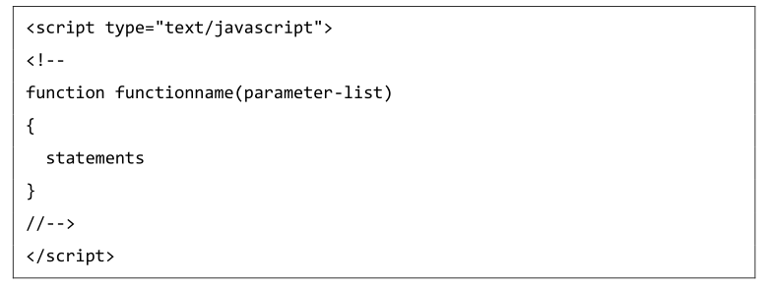
Function Syntax

Slide 39
Example
<html>
<head>
<script type="text/javascript">
function sayHello()
{
document.write ("Hello there!");
}
</script>
</head>
<body>
<p>Click the following button to call the function</p>
<form>
<input type="button" onclick="sayHello()" value="Say Hello">
</form>
<p>Use different text in write method and then try...</p>
</body>
</html>

Slide 40
Function Parameters
<html>
<head>
<script type="text/javascript">
function sayHello(name)
{
document.write ("Hello !“ + name);
}
</script>
</head>
<body>
<p>Click the following button to call the function</p>
<form>
<input type="button" onclick="sayHello(‘jiit’)" value="Say Hello">
</form>
<p>Use different text in write method and then try...</p>
</body>
</html>

Slide 41
Function: return Statement
Add return statements to return control or value to caller

Slide 42
Example
<html>
<head>
<script type="text/javascript">
function sayHello(name)
{
document.write ("Hello there! <br>");
document.write("name ="+ name +" <br>")
newname = func2(name)
document.write("new name "+ newname)
}
function func2(name)
{
result = name + ' my college'
return result
}
</script>
</head> <body>
<p>Click the following button to call the function</p>
<form>
<input type="button" onclick="sayHello('jiit')" value="Say Hello">
</form>
<p>Use different text in write method and then try...</p>
</body></html>

Slide 43
Events

Slide 44
Event
JavaScript's interaction with HTML is handled through events that occur when the user or the browser manipulates a page.
click , pressing any key, closing a window, resizing a window, etc.

Slide 45
Example
<html>
<head>
<script type="text/javascript">
function sayHello()
{
document.write ("Hello there!");
}
</script>
</head>
<body>
<p>Click the following button to call the function</p>
<form>
<input type="button" onclick="sayHello()" value="Say Hello">
</form>
<p>Use different text in write method and then try...</p>
</body>
</html>

Slide 46
onmouseover
The onmouseover event triggers when you bring your mouse over any element

Slide 47
Example
<html>
<head>
<script type="text/javascript">
function over() {
document.write ("Mouse Over");
}
</script>
</head>
<body>
<p>Bring your mouse inside the division to see the result:</p>
<div onmouseover="over()" >
<h2> This is inside the division </h2>
</div>
</body>
</html>

Slide 48
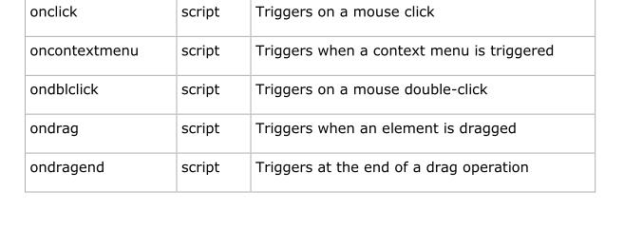
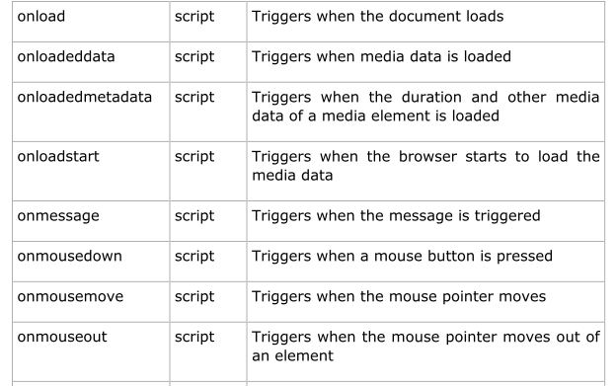
Other Events

Slide 49
Form validation

Slide 50
Form Validation
Form validation normally used to occur at the server.
If the data entered by a client was incorrect or was simply missing, the server would have to send all the data back to the client and request that the form be resubmitted with correct information.
This was really a lengthy process which used to put a lot of burden on the server.
JavaScript provides a way to validate form's data on the client's computer before sending it to the web server

Slide 51
Form Validation
Basic Validation :
Make sure all the mandatory fields are filled in
Data Format Validation
The data that is entered must be checked for correct form and value

Slide 52
Form Validation
<html>
<head>
<title>Form Validation</title>
<script type="text/javascript">
// Form validation code will come here.
</script>
</head>
<body>
<form action="/cgi-bin/test.cgi" name="myForm" onsubmit="return(validate());">
<table cellspacing="2" cellpadding="2" border="1">
<tr>
<td align="right">Name</td>
<td><input type="text" name="Name" /></td>
</tr>
<td align="right"></td>
<td><input type="submit" value="Submit" /></td>
</tr>
</table> </form></body> </html>

Slide 53
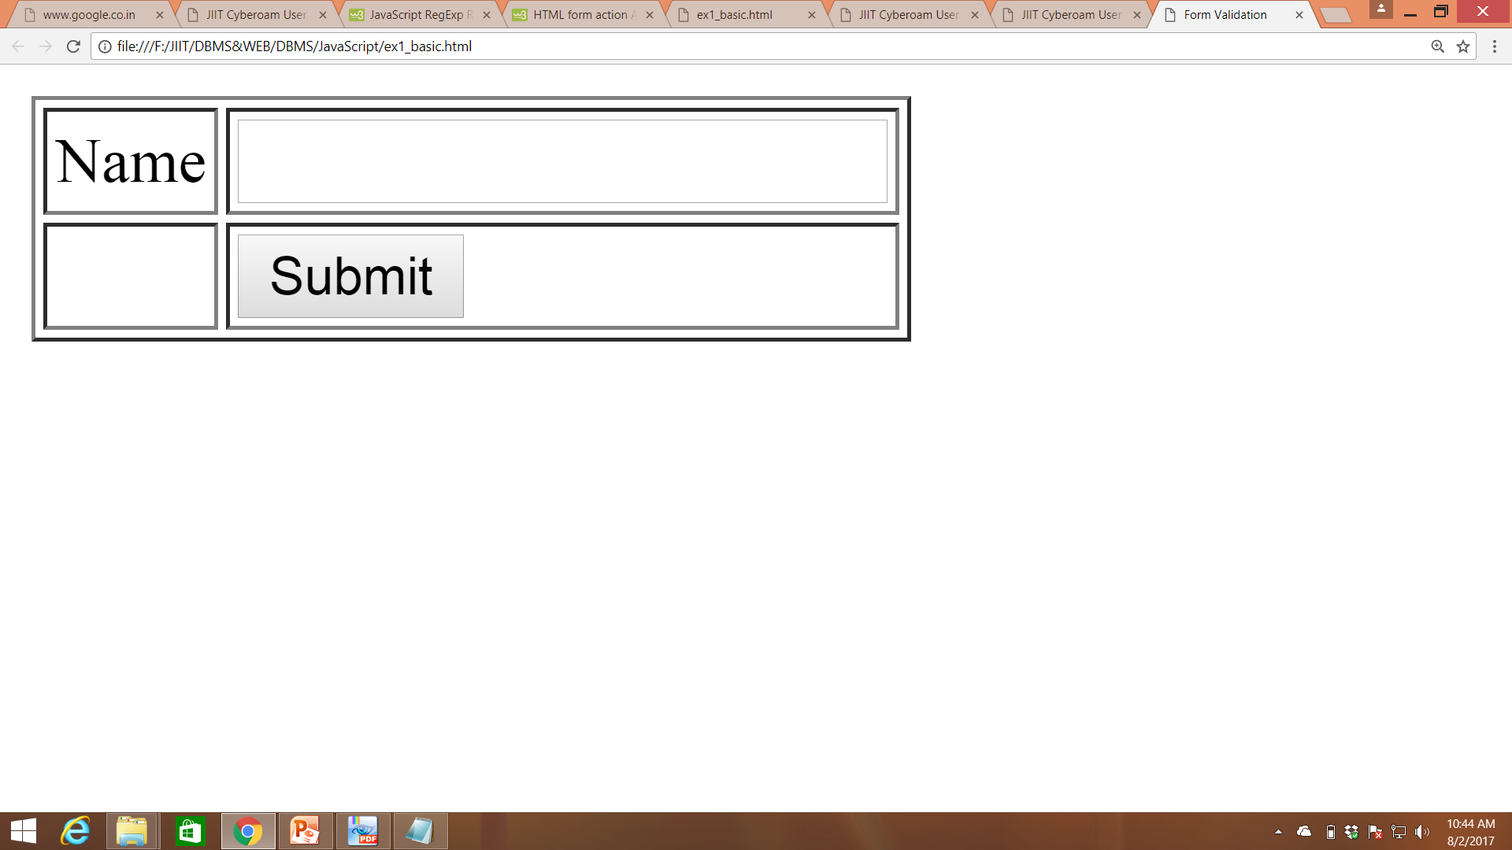

Slide 54
Form Validation
Validate function
function validate() {
if( document.myForm.Name.value == "" )
{ alert( "Please provide your name!" );
return false; }
return true
}

Slide 55
Form Validation Ex1: (Basic)
<html> <head> <title>Form Validation</title>
<script type="text/javascript">
function validate() {
if( document.myForm.Name.value == "" )
{ alert( "Please provide your name!" );
return false; }
return true
}
</script>
</head> <body>
<form action="/cgi-bin/test.cgi" name="myForm" onsubmit="return(validate());">
<table cellspacing="2" cellpadding="2" border="1">
<tr>
<td align="right">Name</td>
<td><input type="text" name="Name" /></td>
</tr>
<td align="right"></td>
<td><input type="submit" value="Submit" /></td>
</tr>
</table> </form></body> </html>

Slide 57
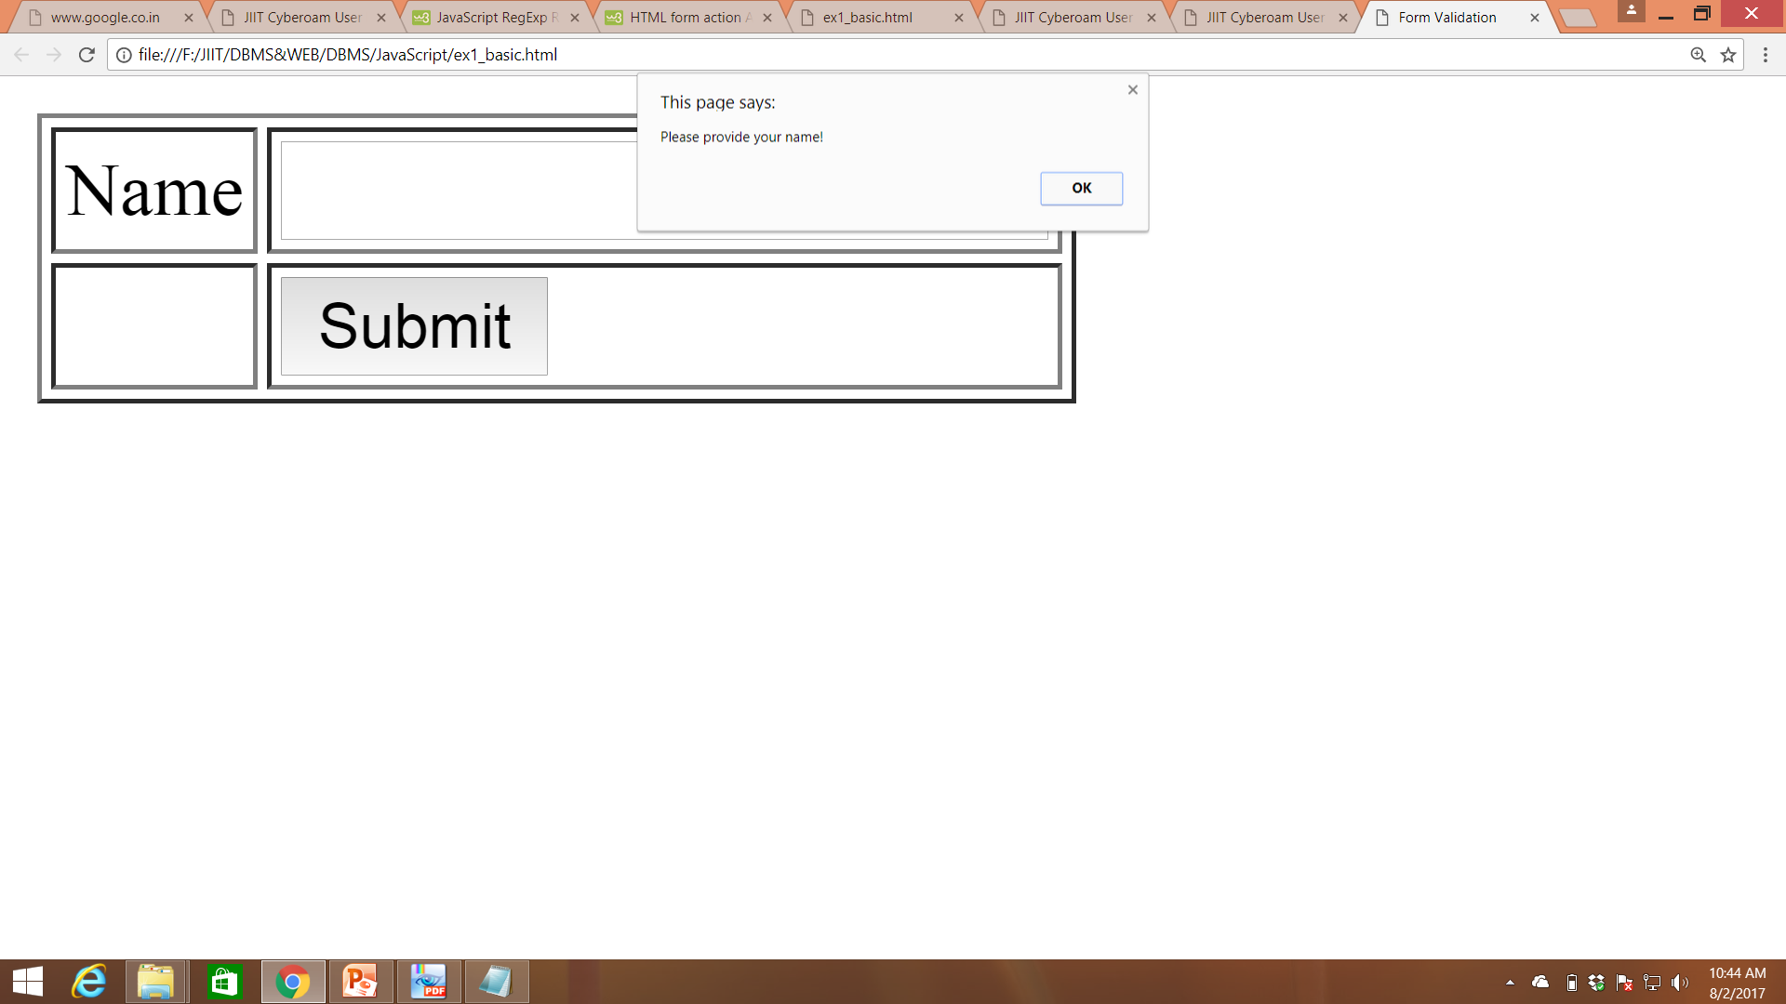

Slide 58
Form Validation: Ex-2 (Email)
<html> <head> <title>Form Validation</title>
<script type="text/javascript">
function validate() {
if( document.myForm.Name.value == "" )
{ alert( "Please provide your name!" ); return false; }
if( document.myForm.Email.value == "" ) {
alert( "Please provide your email!" ); return false; }
return true
}
</script>
</head> <body>
<form action="/cgi-bin/test.cgi" name="myForm" onsubmit="return(validate());">
<table cellspacing="2" cellpadding="2" border="1">
<tr>
<td align="right">Name</td>
<td><input type="text" name="Name" /></td>
</tr>
<tr>
<td align="right">Email</td>
<td><input type="text" name="Email" /></td>
</tr>
<tr>
<td align="right"></td>
<td><input type="submit" value="Submit" /></td>
</tr>
</table> </form></body> </html>

Slide 59
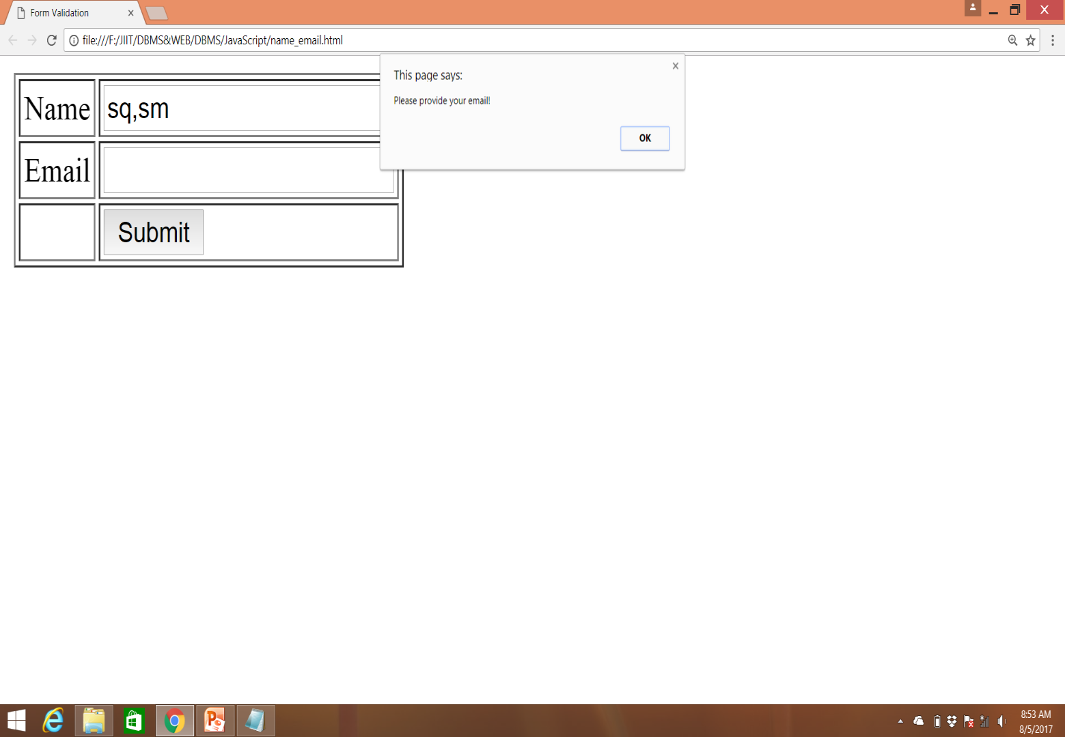

Slide 60
Data field validation

Slide 61
Data Validation
Q: Take an input and check if its is a number or not.

Slide 62
Example -3
<html> <body>
<h1>JavaScript Can Validate Input</h1>
<p>Please input a number between 1 and 10:</p>
ID:<input id="numb"> <br>
<button type=“button" value= "submit" onclick="myFunction()">
<br>
<p id="demo"></p>
<script>
function myFunction() { var x, text;
// Get the value of the input field with id="numb"
x = document.getElementById("numb").value;
// If x is Not a Number or less than one or greater than 10
if (isNaN(x) || x < 1 || x > 100) {
text = "Input not valid";
} else {
text = "Input OK";
}
document.getElementById("demo").innerHTML = text;
}
</script> </body> </html>

Slide 63
Example 4
Q. Check whether input has email of valid length or not?

Slide 64
User Name and password
<html> <body> <script>
function validateform(){
var name=document.myform.name.value;
var password=document.myform.password.value;
if (name==null || name==""){
alert("Name can't be blank");
return false;
}else if(password.length<6){
alert("Password must be at least 6 characters long.");
return false;
} }
</script>
<form name="myform" method="post" action="abc.jsp" onsubmit="return validateform()" >
Name: <input type="text" name="name"><br/>
Password: <input type="password" name="password"><br/>
<input type="submit" value="register">
</form> </body> </html>

Slide 65
Example 5
Q. Check if the email has valid format or not?

Slide 66
Email Validation
<script type="text/javascript">
<!--
function validateEmail()
{
var emailID = document.myForm.EMail.value;
atpos = emailID.indexOf("@");
dotpos = emailID.lastIndexOf(".");
if (atpos < 1 || ( dotpos - atpos < 2 ))
{
alert("Please enter correct email ID")
return false;
}
return( true );
}
//-->
</script>

Slide 67
Date Validation
<html><body>
<script type="text/javascript">
function validateEmail()
{
var emailID = document.myForm.EMail.value;
atpos = emailID.indexOf("@");
dotpos = emailID.lastIndexOf(".");
if (atpos < 1 || ( dotpos - atpos < 2 ))
{
alert("Please enter correct email ID")
return false;
}
return( true );
}
</script>
<form action="/cgi-bin/test.cgi" name="myForm" onsubmit="return validateEmail()">
<table cellspacing="2" cellpadding="2" border="1">
<td align="right">Email</td>
<td><input type="text" name="Email" /></td>
</tr>
<tr>
<td align="right"></td>
<td><input type="submit" value="Submit" /></td>
</tr>
</table> </form></body> </html>

Slide 68
Regular Expressions

Slide 69
Example
Find name of all the students starting with ‘a’
A+

Slide 70
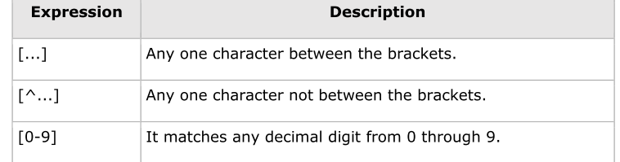
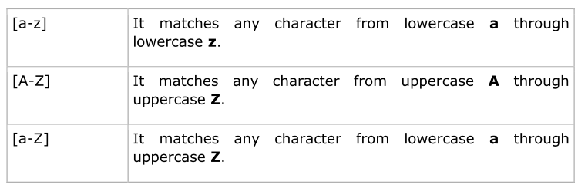
Brackets

Slide 71
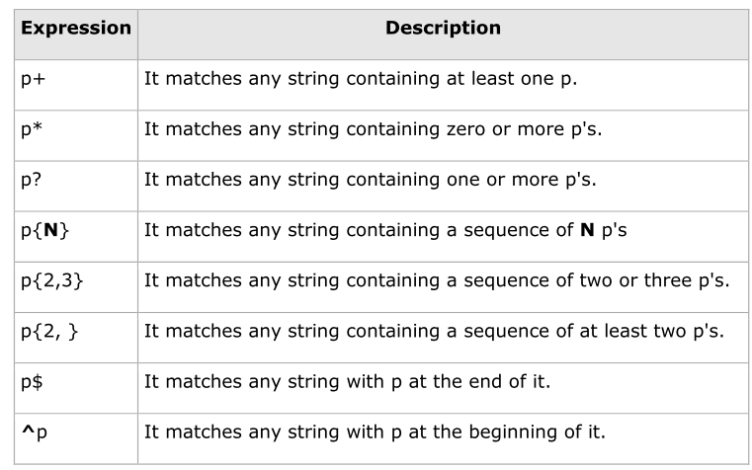
Quantifiers

Slide 72
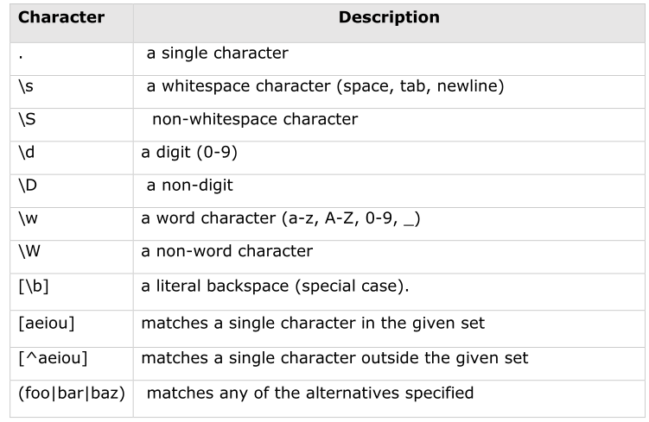
Metacharacters

Slide 73
Metacharacters

Slide 74
Q: check that name can have only numeric values.

Slide 75
Example 6
<html>
<head> <title>hello</title>
<script>
var ck_name ="[a-Z]+"
function validate()
{
var name1 = document.myform.name.value;
var a=ck_name.match(name1);
document.write("name="+ name1+" a="+a);
if(!ck_name.match(name1))
{
alert("Not valid");
return false;
}
}
</script>
</head>
<body>
<form action = "/a.asp" name = "myform" onsubmit = "return(validate())">
Name<input type = "text" name= "name"><br>
<input type="submit" value ="submit" >
</body>
</html>

Slide 76
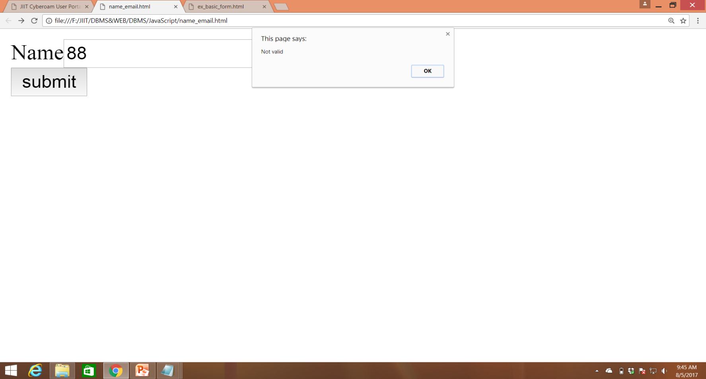

Slide 77
Objects

Slide 78
JavaScript Objects
JavaScript is an Object Oriented Programming (OOP) language.
Objects are composed of attributes
Object properties can be any of the three primitive data types, or any of the abstract data types, such as another object.
Object Methods
Methods are the functions that let the object do something or let something be done to it.

Slide 79
Example
Attribute
var str = document.title;
Method
document.write ("This is test");

Slide 80
Objects
User defined objects
var employee = new Object();

Slide 81
Object: Ex1
<html> <head>
<title>User-defined objects</title>
<script type="text/javascript">
var book = new Object(); // Create the object
book.subject = "Perl"; // Assign properties to the object
book.author = "Mohtashim";
</script>
</head>
<body>
<script type="text/javascript">
document.write("Book name : " + book.subject + "<br>");
document.write("Book author : " + book.author + "<br>");
</script> </body> </html>

Slide 82
Object: Ex2 (object with a User-Defined Function.)
<html>
<head>
<title>User-defined objects</title>
<script type="text/javascript">
function book(title){
this.title = title;
}
</script>
</head>
<body>
<script type="text/javascript">
var myBook = new book("Perl", "Mohtashim");
document.write("Book title is : " + myBook.title + "<br>");
</script>
</body>
</html>

Slide 83
Try the following example; it shows how to add a function along with an object.
<html><head>
<title>User-defined objects</title>
<script type="text/javascript">
// Define a function which will work as a method
function addPrice(amount){
this.price = amount;
}
function book(title, author){
this.title = title;
this.author = author;
this.addPrice = addPrice; // Assign that method as property.
}
</script>
</head><body>
<script type="text/javascript">
var myBook = new book("Perl", "Mohtashim");
myBook.addPrice(100);
document.write("Book title is : " + myBook.title + "<br>");
document.write("Book author is : " + myBook.author + "<br>");
document.write("Book price is : " + myBook.price + "<br>");
</script>
</body></html>

Slide 84
Output:
Book title is : Perl Book author is : Mohtashim Book price is : 100

Slide 85
Image Map
It define the clickable hotspots
The <map> tag is used to define a client-side image-map.

Slide 86
Example
<!DOCTYPE html>
<html>
<body>
<p>Click on the sun or on one of the planets to watch it closer:</p>
<img src="planets.gif" width="145" height="126" alt="Planets" usemap="#planetmap">
<map name="planetmap">
<area shape="rect" coords="0,0,82,126" alt="Sun" href="sun.htm">
<area shape="circle" coords="90,58,3" alt="Mercury" href="mercur.htm">
<area shape="circle" coords="124,58,8" alt="Venus" href="venus.htm">
</map>
</body>
</html>

Slide 87
Example: Explain what is happening?
<html>
<head>
<script>
function moveNumbers(number){
document.getElementById("result").value=number;
}
</script>
</head>
<body>
<form>
Select numbers:<br>
<input type="button" value="1" name="no" onclick="moveNumbers(value)">
<input type="button" value="2" name="no" onclick="moveNumbers(value)">
<input type="button" value="3" name="no" onclick="moveNumbers(value)">
<input type="text" id="result" size="20">
</form>
</body>
</html>

